Slide 1
Use Git
Or any other version control system

Slide 2
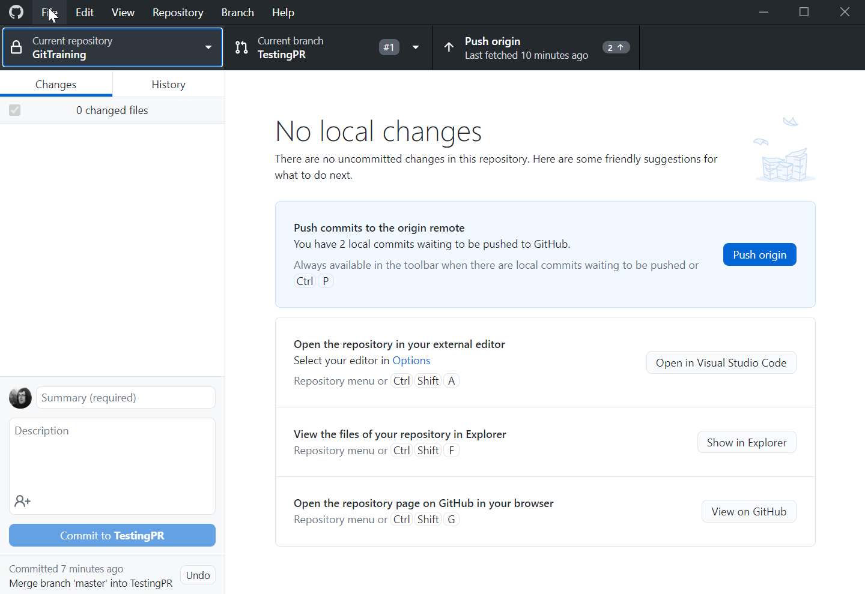
Got GitHub desktop?
https://desktop.github.com/
Simple and lightweight
Does not allow for all the Git complexity
(Or choose a client of your own)
Set up a GitHub account and sign in

Slide 3
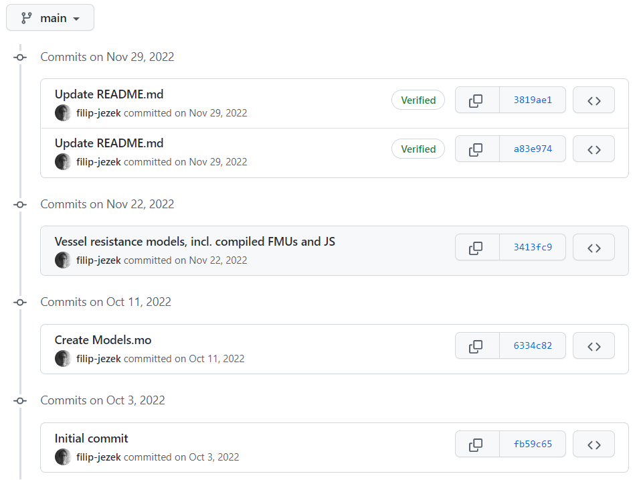
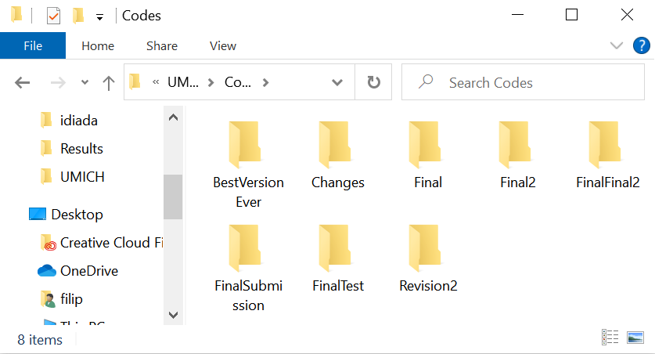
GIT: Get organized!

Slide 4

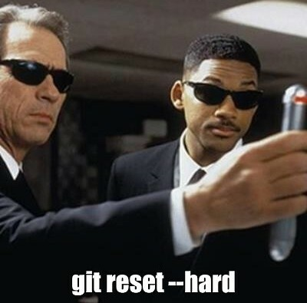
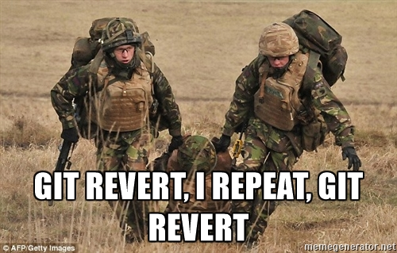
Git: Prepare for a mistake!
Made a big oops?
Overwrote an important file?
The project JUST does not run?

Slide 5
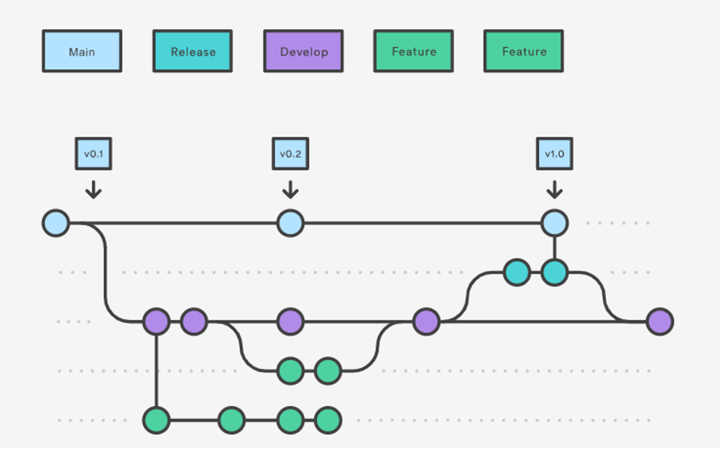
GIT: More versions of the same project
Hell to maintain?
Branches might merge back when successful, or die out

Slide 6



GIT: Get backed up!
GitHub:
Do not forget about the data!

Slide 7
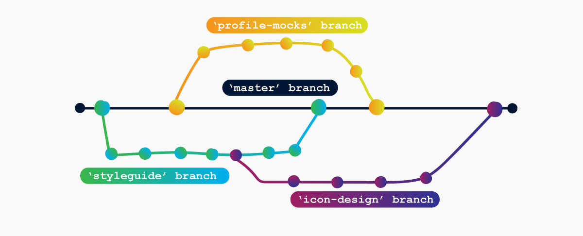
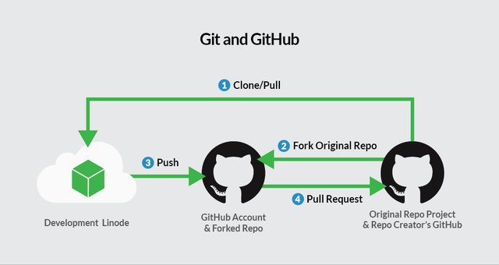
Git: Collaborate!
Invited collaborators
Pull requests from wide public

Slide 8
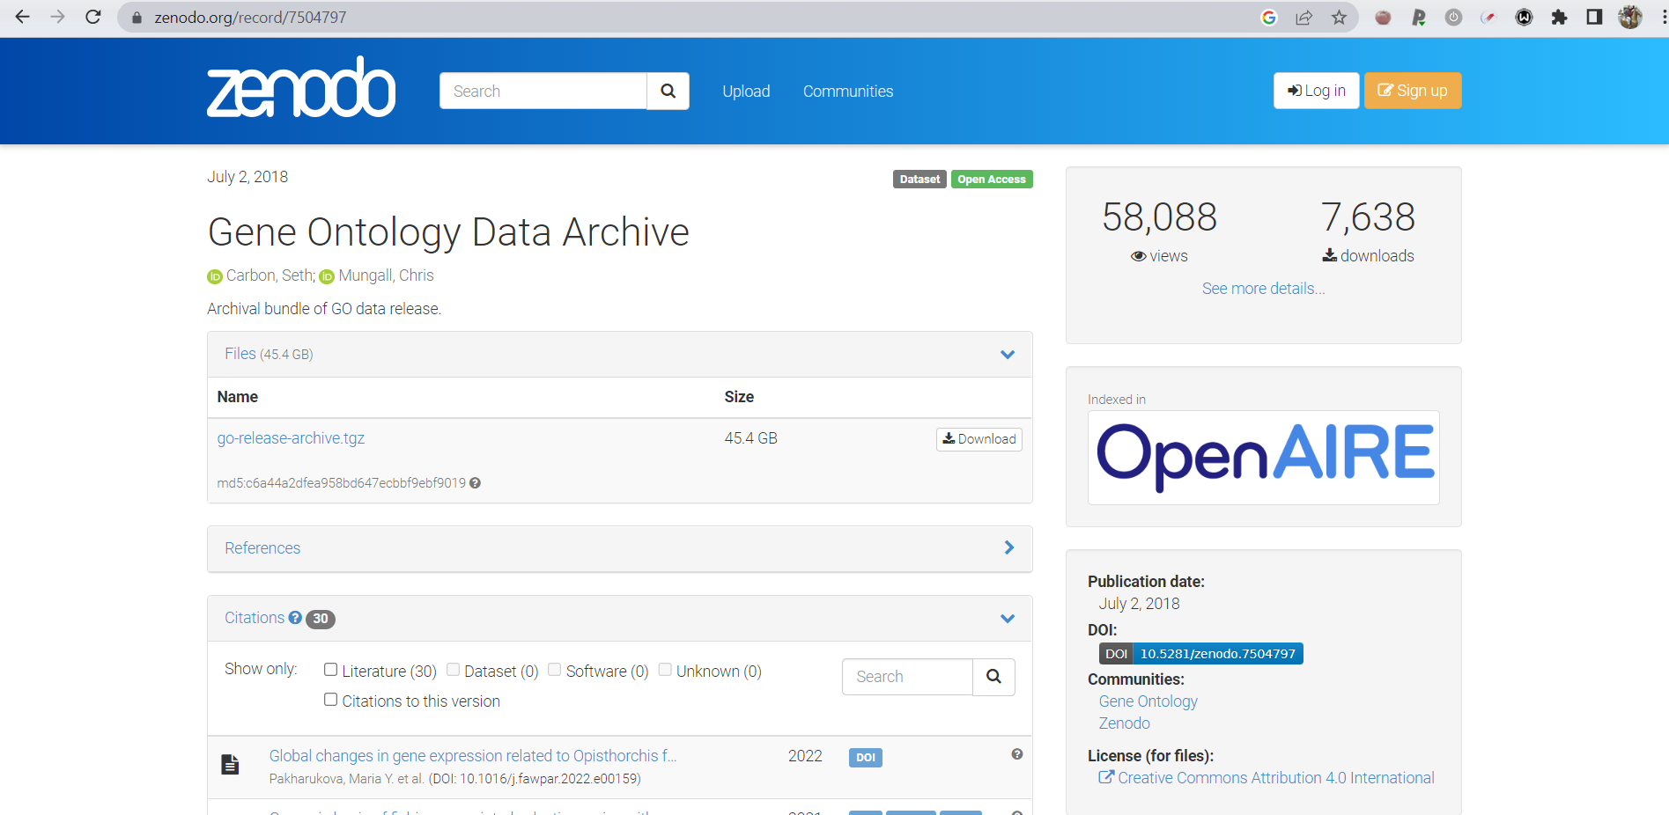
Git: Make your research public
A link to GitHub would do too
Dedicated storage repository - Zenodo - pin a release

Slide 9
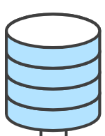



What is a Git Repository?
Repository: history and branches
Working copy: files on the drive
(usually in hidden subfolder, e.g. .git)
Just a folder with some extras..

Slide 10



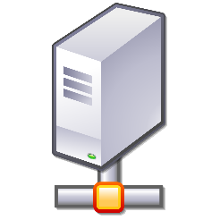


Process
DO THIS AS OFTEN AS POSSIBLE
File system
Local
Repository
Remote
Repository
Stage
Commit
Pull
Push
Do this for collaboration and backup

Slide 11
Hands on

Slide 12
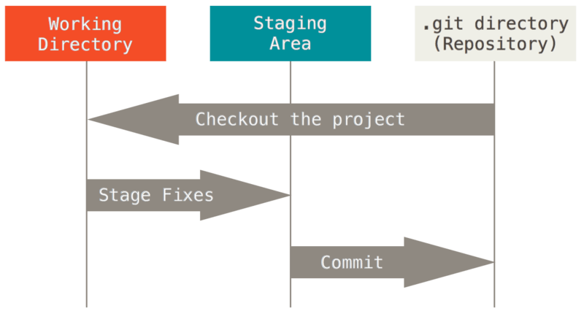
First commit, where we initialize
Initialize a new repository
Add a readme.md file, write down the “Hello world” line
Git commit
  Staging level
  Commit message
https://git-scm.com/book/en/v2

Slide 13
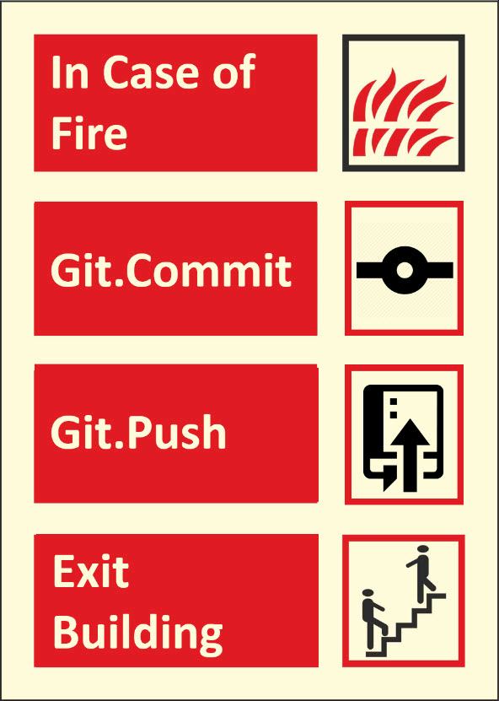
Second commit, where we extend and ignore
Add a line to the readme.md below the hello world:
“This is our testing repository”
Add data/topsecretfile.md
Add generatedfile.mat
Add .gitignore file
  Data/
  *.mat
Commit
Push (publish)

Slide 14


.gitignore
Commit only the sources, not the products!
  NO output and intermediate files
  NO secret data not to be shared
=> Ignore staging
.gitignore
  A specialized file stores what should be ignored at staging
  also versioned, can be ignored :)
  In any folder
  Names: topsecretfile.txt
  Wildcards: /*.mat
IGNORED FILES LIVE ONLY IN YOUR FOLDER
NO DISCARD
NO REVERT
NO CONTROL ON BRANCH SWITCH

Slide 15
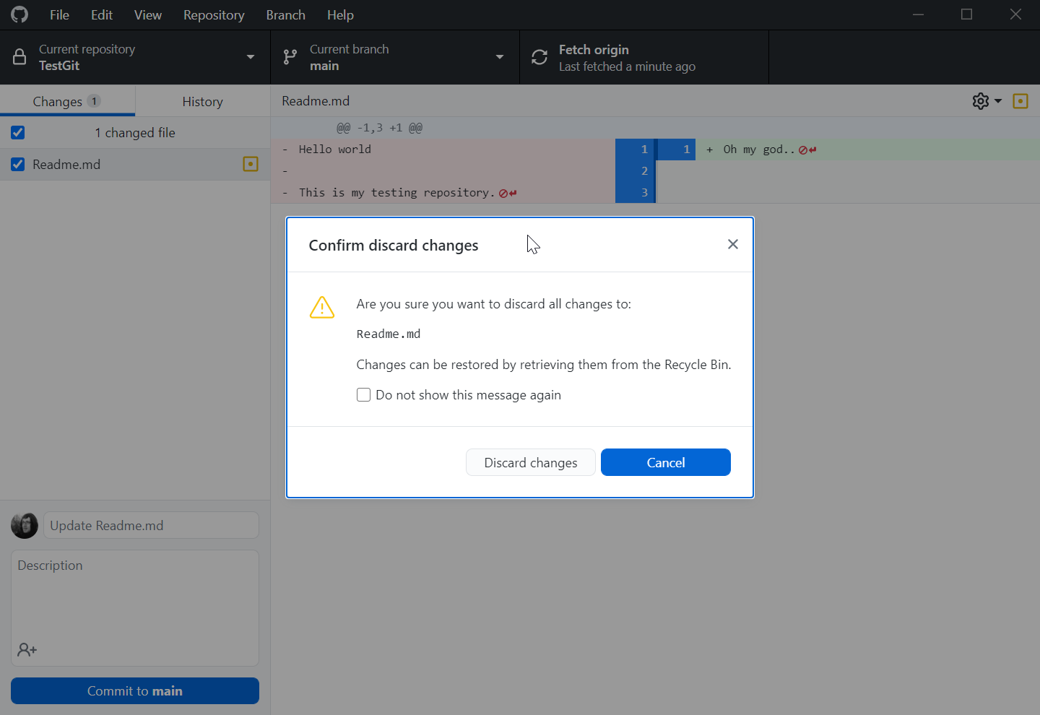
Third commit, where we mess up
Delete the content of the readme.md
  Revert
Mess up again and commit
  Undo commit (if it was not pushed)
    The files stay modified
  Reset to… (if it was not pushed)
    The files get reset too
Push
  Revert the commit (not always possible)
  View file on GitHub to get previous version (always there)
  Make a branch on previous commit (Full working state)

Slide 16
I messed up. What now?
Situation | Fix | Notes
Wrong commit message (not pushed) | git commit --amend | GUI: right-click the last commit ▸ Amend
Staged the wrong file | git restore --staged <file> | GUI: untick it
Throw away edits to a file | git restore <file> | GUI: Discard changes. Not recoverable
Undo last commit, keep the edits | git reset --soft HEAD~1 | GUI: Undo commit
Undo last commit and the edits | git reset --hard HEAD~1 | Only if it was never pushed
Already pushed — undo it | git revert <commit> | Makes a new, opposite commit. Safe for others
Just look at an old version | git switch --detach <commit> | Look, do not edit
Continue from an old commit | git switch -c fix <commit> | Full working state, new branch
“I destroyed everything” | git reflog | Every HEAD you have had, ~90 days. Find the hash, branch to it
Committed a huge or secret file | git rm --cached <file> | Rotate the secret first, then rewrite history
The rule: anything committed can be recovered. Anything never committed cannot. That is the whole argument for committing often.
Notes:
The one rule: anything COMMITTED can be recovered. Anything never committed cannot. That is the argument for committing often.

Slide 17
That’s it!
… let’s see some advanced stuff with branching!

Slide 18
Fourth commit, where we branch
We want to add something without touching the working version
Branch ▸ New branch… → call it add-wisdom, based on main
Add a file wisdom.md with one line of wisdom in it
Commit → Publish branch
The branch shown in the top bar is the one you are standing on:
  Switch back to main — wisdom.md disappears from the folder
  Switch to add-wisdom — it is back
  The files on your disk follow the branch. Nothing was deleted.
Notes:
Let them watch the file appear and disappear in the file explorer. That is the moment branches stop being abstract.

Slide 19
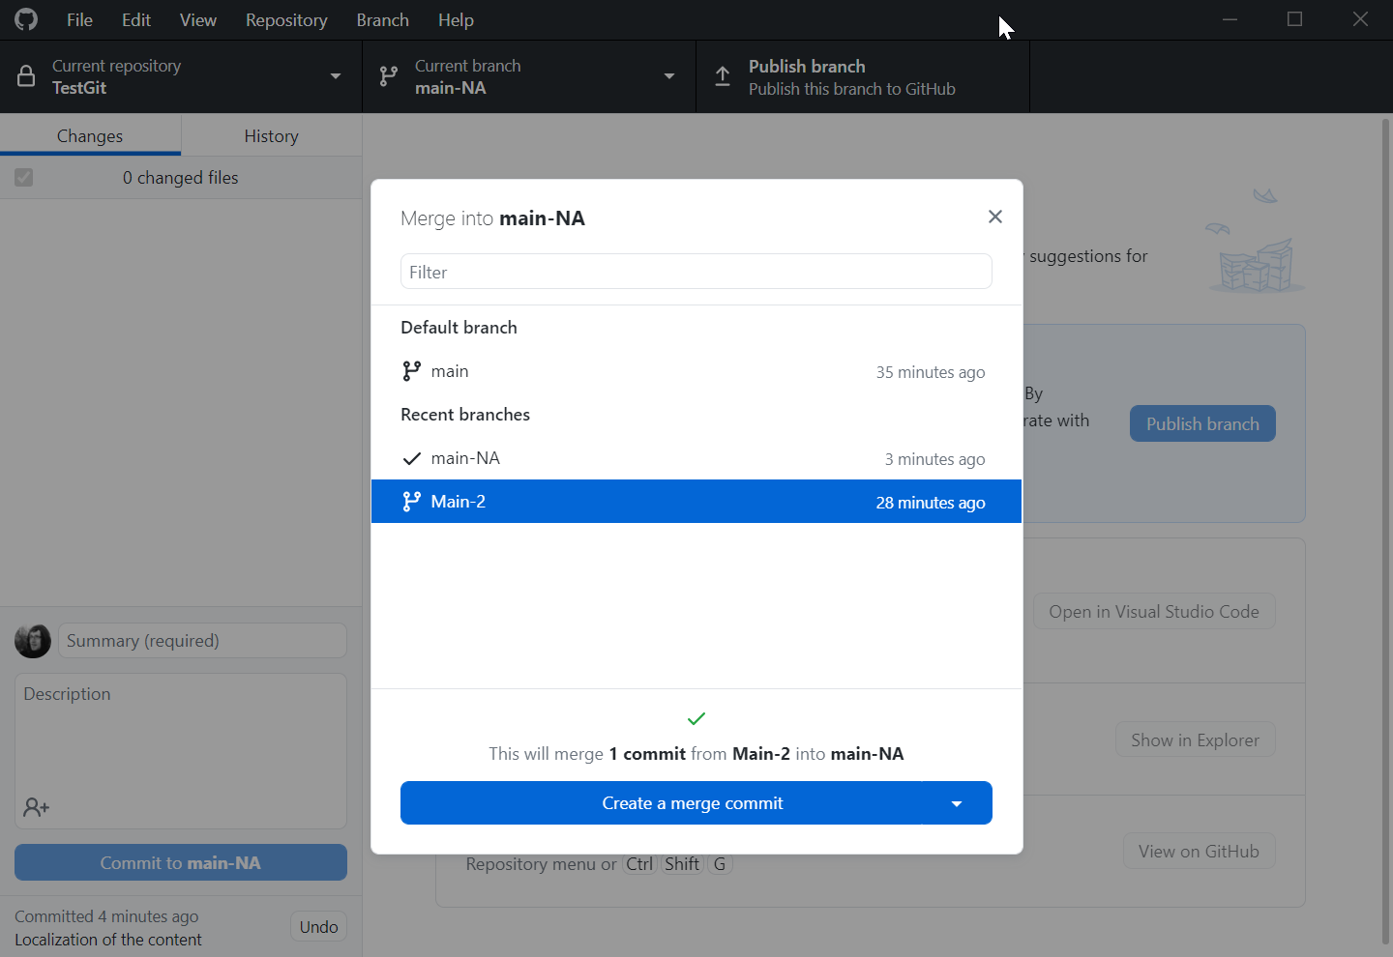
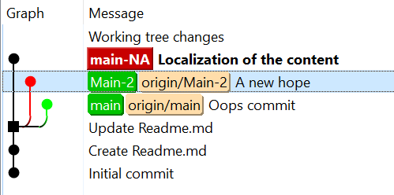
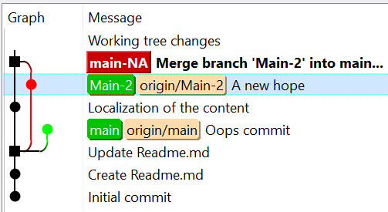
Fifth commit, where we merge — the easy one
The wisdom turned out fine. Bring it into main.
Switch to main
Branch ▸ Merge into current branch… → pick add-wisdom
No conflict — nobody touched those lines on main, so Git just does it
Push
add-wisdom has done its job. You may delete it — the commits stay in main.
This is what a normal merge looks like. Most of them are this boring.
Notes:
Teach the happy path first, deliberately. The conflict later then reads as the exception it actually is, not as the normal behaviour of Git.

Slide 20
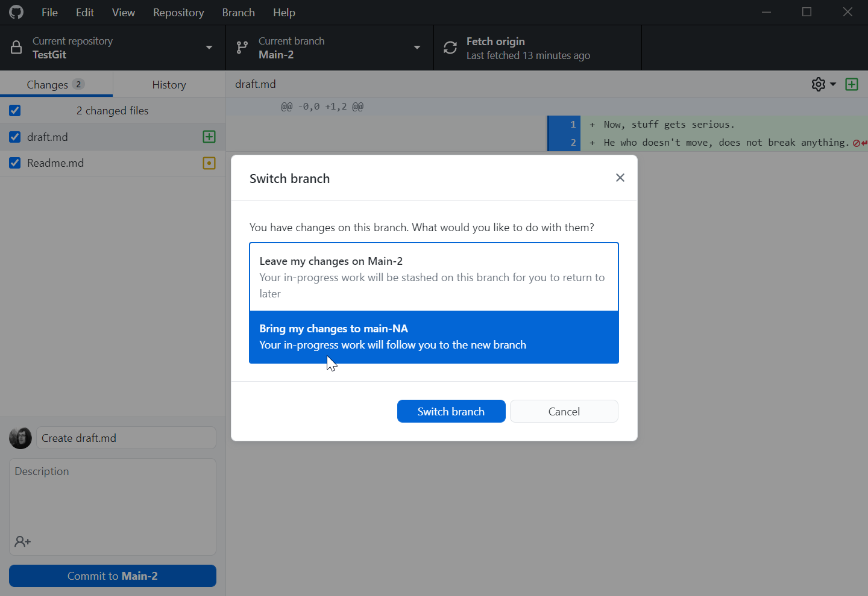
Sixth commit, where we experiment
Now something riskier: a different greeting — but only as an experiment
Branch ▸ New branch… → greeting-na, based on main
In readme.md, change “Hello world” to “Hello North America”
Commit. Publish the branch.
Your main is untouched and still works.
  That is the entire point of a branch: somewhere to be wrong safely.
Notes:
Name the branch after what it does. 'main-2' tells you nothing in three weeks.

Slide 21
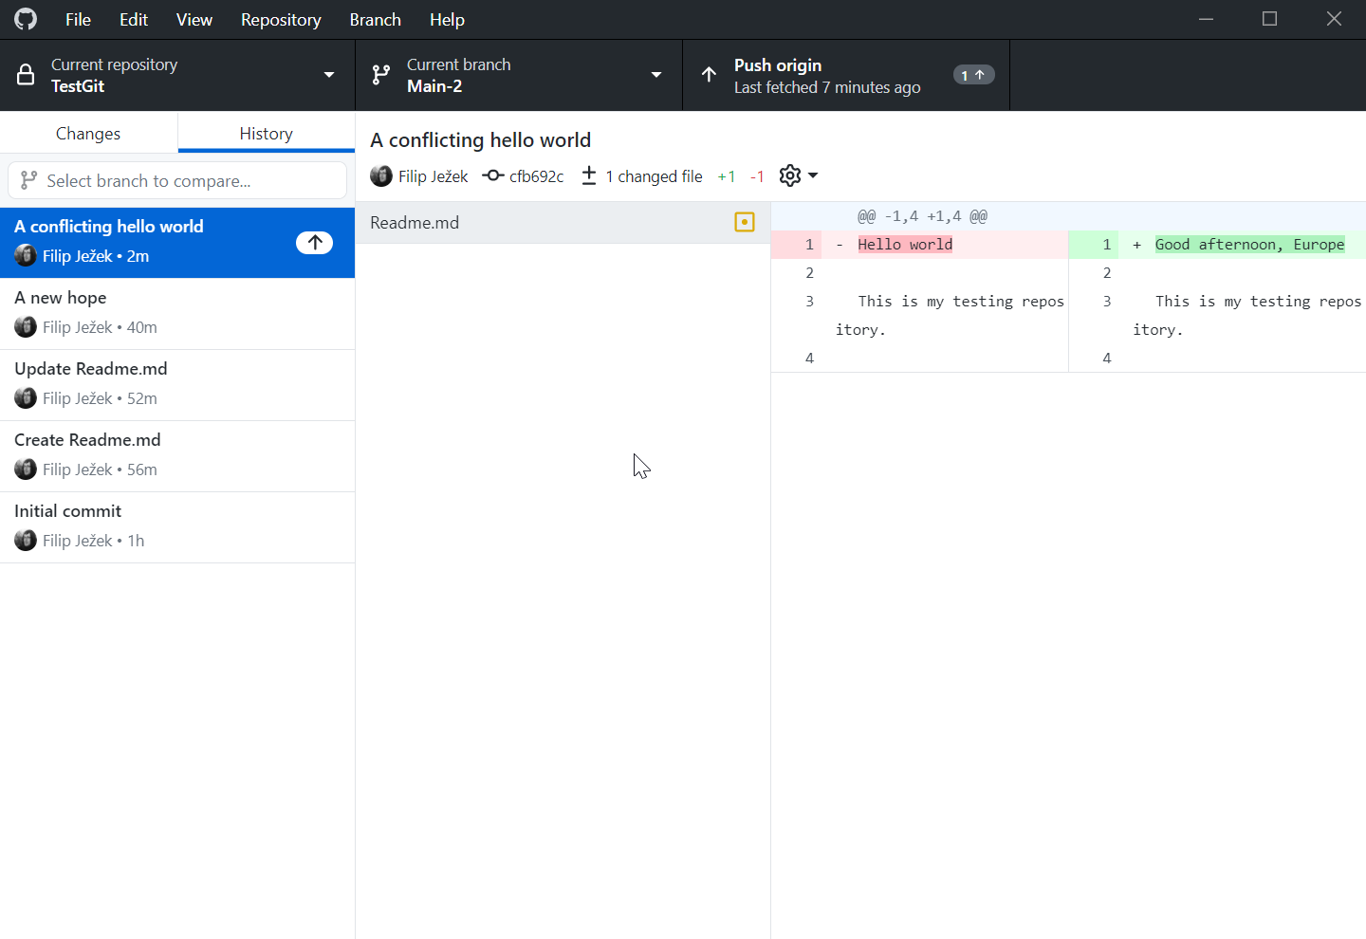
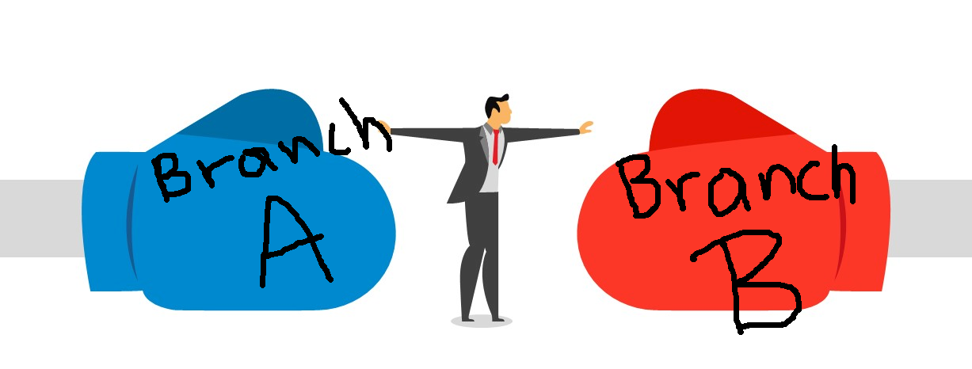
Seventh commit, where we diverge
Meanwhile, life goes on the main line.
Switch to main
Change the same greeting line to “Good afternoon, Europe”
Commit
Now the same line says two different things on two branches.
  This is a concurrent change, not an addition
  Git merges additions and deletions by itself all day long
  But here it genuinely cannot know which one you meant — so it will ask
Notes:
Stress that we are engineering this on purpose. In real work most merges never conflict, because people edit different lines.

Slide 22
Worktrees: several working copies at once
The situation: you are mid-experiment, the code half works — and you need the working version to compare against, or to review a colleague's pull request
  So far your options were: commit garbage, stash, or clone the whole repo again
A worktree is a second folder on disk, on a different branch, sharing one repository and one history
  No second clone, no duplicated history, nothing re-downloaded
  Commit in either folder — it is the same repository
Why this matters for modelling
  Run the old and the new model side by side, two MATLAB/Python sessions, and diff the outputs
  Let a long simulation keep running on main while you edit a branch
  Review a PR without destroying your working state
Limit: the same branch cannot be checked out in two worktrees at once
Notes:
This is the slide that sells worktrees to a modelling audience: comparing two model versions numerically is a daily task, and it normally means two clones.

Slide 23
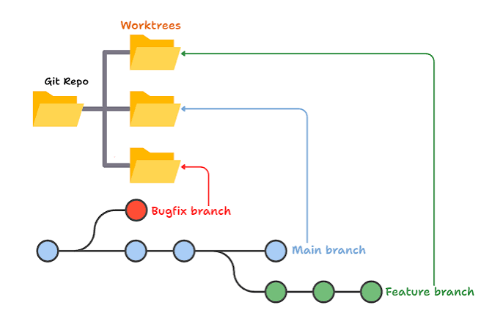
Worktrees: how
GitHub Desktop 3.6 (June 2026) added them — it is no longer CLI-only
  Repository ▸ New Worktree… → give it a name; leave the branch blank to make a new one
  A Current Worktree menu appears next to Current Repository and Current Branch
  Switching worktree switches the folder and the branch together — that is the whole idea
  Right-click a linked worktree ▸ Delete… (it refuses if you have uncommitted changes)
  You cannot rename or delete the main worktree
Command line
  git worktree add ../proj-main main
  git worktree list
  git worktree remove ../proj-main
Rule of thumb: put them next to the repo, never inside it, and delete them when done.
Notes:
Inside the repo they would show up as untracked files. Next to it, e.g. Phys520/ and Phys520-main/.

Slide 24
Try it: both greetings at once
You now have the same line saying two different things on two branches.
Switching back and forth to compare them is exactly the annoyance worktrees remove.
You are standing on main. Put greeting-na into a second folder:
  Repository ▸ New Worktree… → Name: gitintro-na, Branch: greeting-na
  Command line: git worktree add ../gitintro-na greeting-na
Open both folders side by side — two VS Code or MATLAB windows
  The original folder says “Good afternoon, Europe”
  The new folder says “Hello North America”
  Same repository, same history, two working copies
Why the new folder gets `greeting-na` and not `main`: a branch can be checked out in only one worktree at a time, and main is already here.
When you are done: right-click the worktree ▸ Delete
For real work: run the old and the new model side by side and diff the outputs.
Notes:
Verified in a dry run: asking for a worktree on 'main' while standing on main fails with "'main' is already used by worktree at ...". Always put the OTHER branch in the new folder. Keep it next to the repo, never inside it.

Slide 25
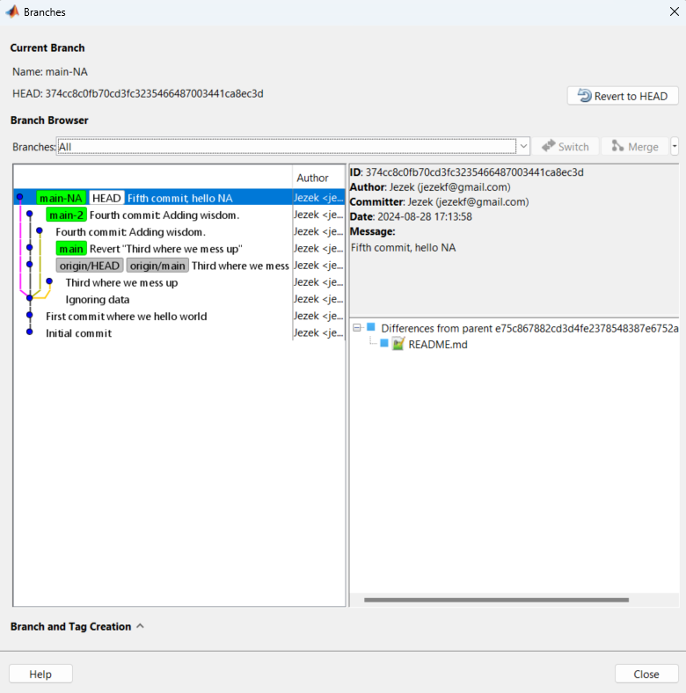
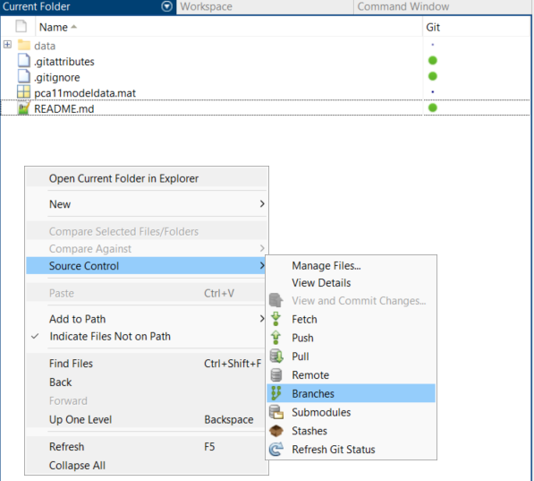
Let’s use Matlab to see the branches
Navigate to the folder in Matlab
Right-click – Source control - Branches

Slide 26
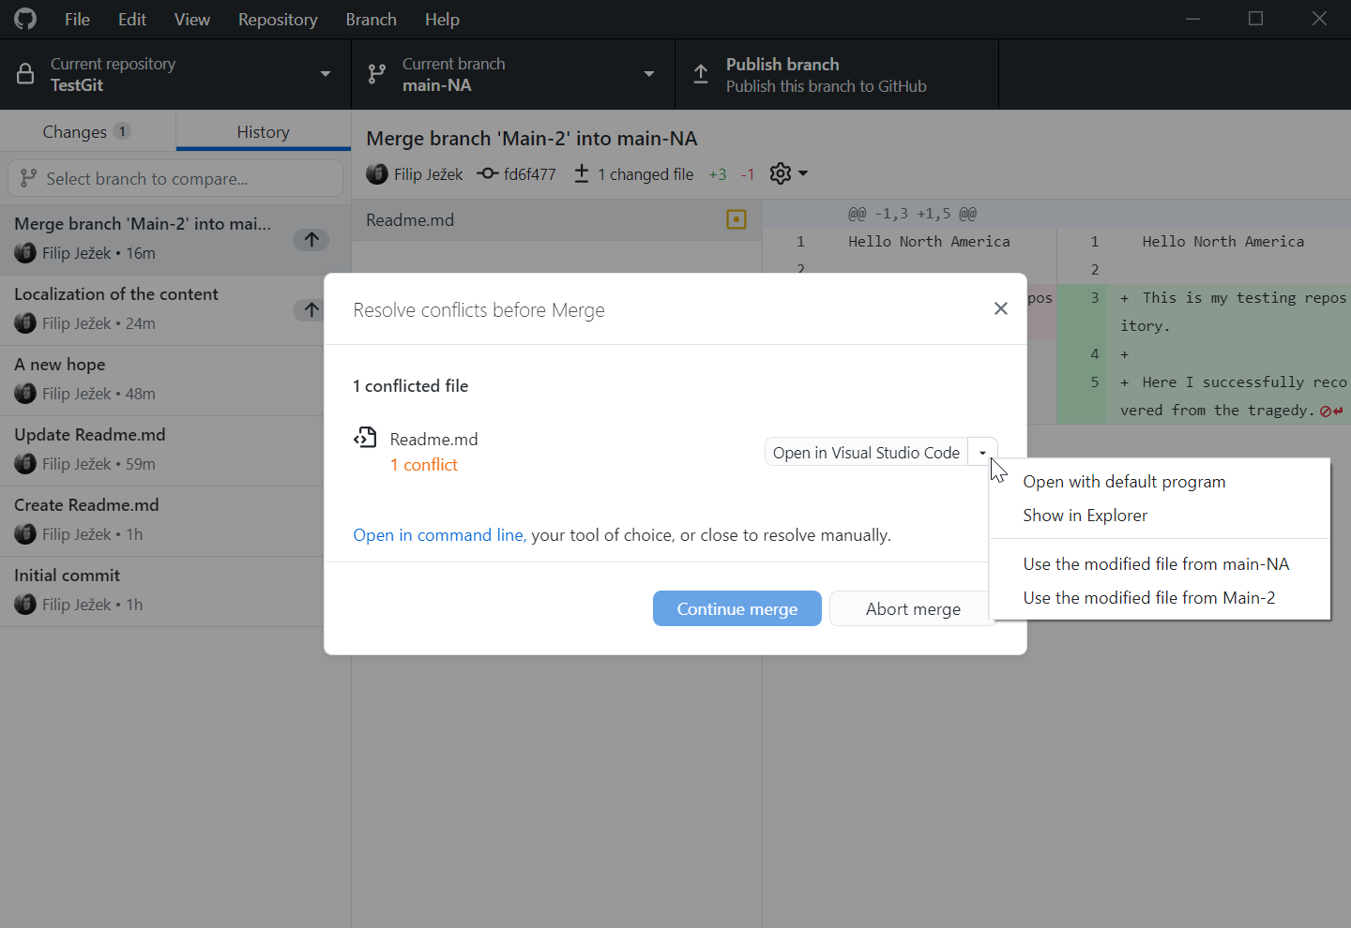
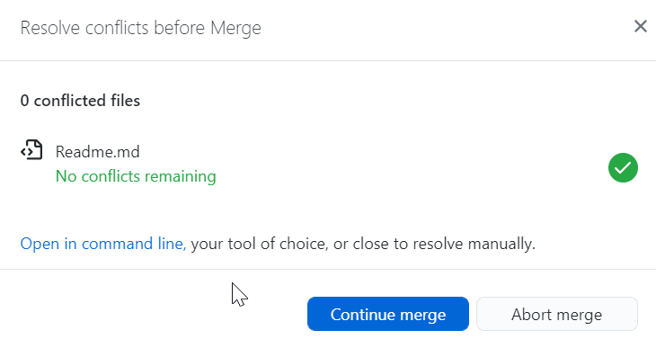
Eighth commit, where we conflict and resolve
Bring main's change into the experiment:
  Switch to greeting-na → Branch ▸ Merge into current branch… → pick main
Git stops and writes both versions into the file:
  <<<<<<< HEAD
  Hello North America
  =======
  Good afternoon, Europe
  >>>>>>> main
Open the file, delete the markers, leave the text you want —
  e.g. “Hello Europe and North America”
Then commit the merge.
GitHub Desktop offers to open VS Code, which adds Accept current / incoming / both buttons.
Notes:
Do this one slowly. Resolving is just editing a text file until it is right - there is no magic Git operation involved.

Slide 27
Merge conflicts: the reference card
What you see | What it means | What to do
<<<<<<< HEAD | Everything below is your branch — the one you are standing on | Keep, edit or delete it
======= | The divider between the two versions | Delete this line
>>>>>>> main | Everything above came from the branch you are merging in | Keep, edit or delete it
A file marked Conflicted | Git stopped; it will not guess for you | Edit the file until it is correct, then stage it
“I want the whole merge undone” | Nothing is committed yet | git merge --abort (GUI: Abort merge)
A binary file (.slx .mat .png) | No line-by-line merge exists | Choose one version whole — mine or theirs
Notes:
The line to say out loud: resolving a conflict is not a Git operation. It is you editing a file until it is right. Git only tells you where to look.

Slide 28
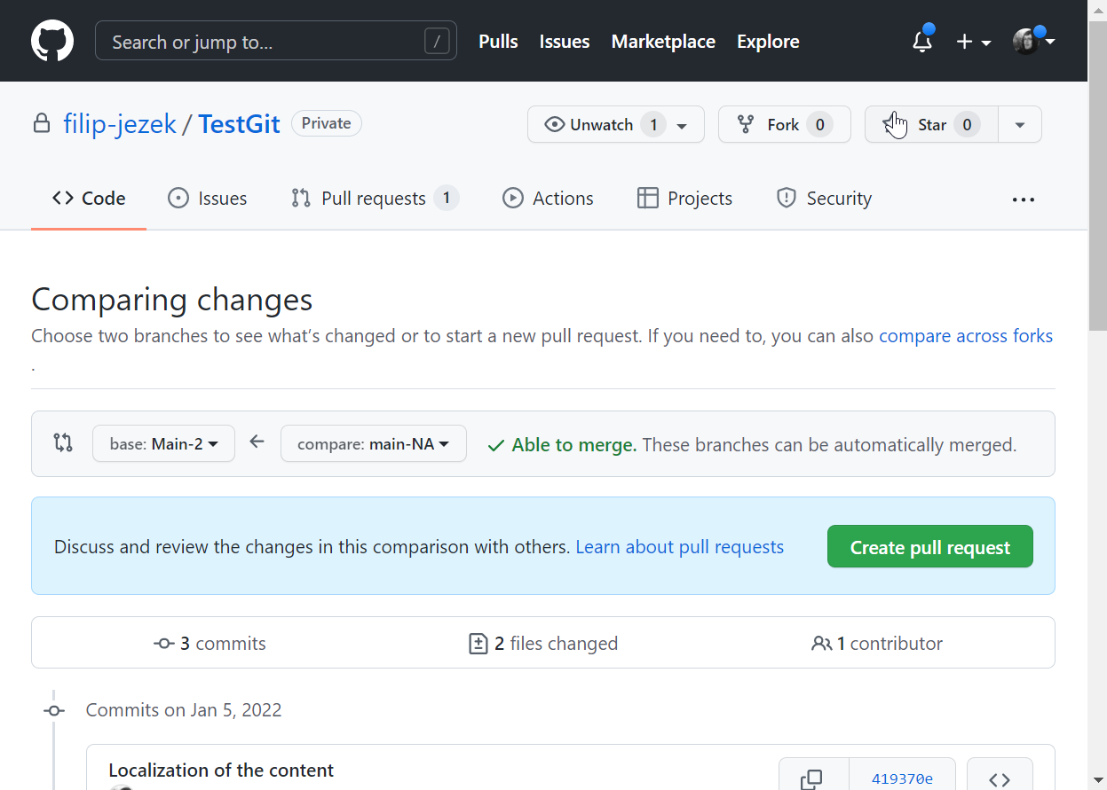
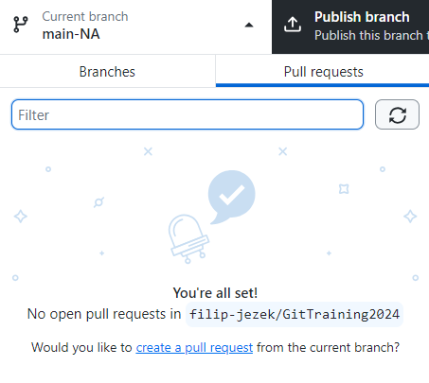
Create a pull request
greeting-na is now newer and better than main everywhere
The GitHub way: we ask to merge greeting-na into main
  GitHub Desktop: Branch ▸ Create pull request
  …or publish, then create the pull request on github.com
GitHub reports no conflicts — we already merged main in, in the last step
DO NOT MERGE YET — one more thing to show.
No conflicts, already newer
DO NOT MERGE YET

Slide 29
Ninth commit — updating a pull request
A pull request is a whole branch, not a fixed set of changes
So: still on greeting-na, add another line to wisdom.md
Commit
Push
Reload the pull request on github.com — the new commit is already in it
  This is how review works: you push fixes, the same PR updates
Now merge it.

Slide 30
Tenth commit is an assignment
Fork github.com/beards-lab/Phys520 to your own account
Clone your fork (File ▸ Clone repository)
Create initials_your-nick-name.md in the 01_GitTutorial folder
  e.g. FJ_jez.md
Write down what you
  1) like about GitHub 2) dislike about GitHub 3) at least one question
Commit, push, and issue a pull request
Already a collaborator? Then clone directly, but push a branch, not main.
Bonus: retrieve the hidden message from the repository.

Slide 31
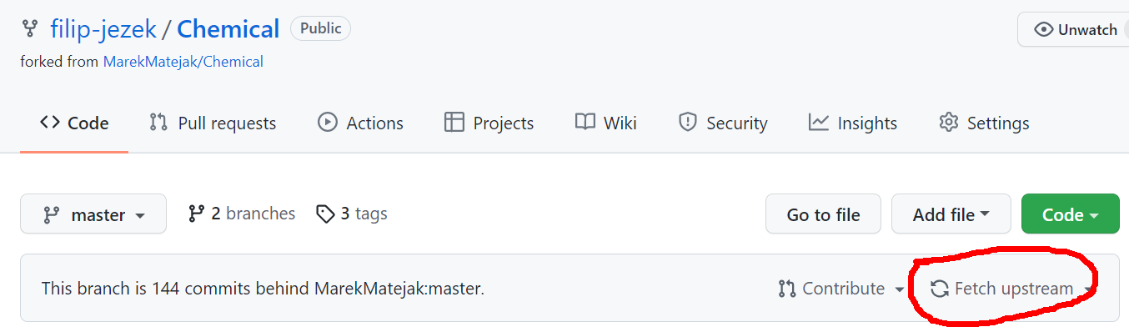
Check-out a repos
File – Clone Repository - URL
Remember to keep your fork in sync!
Branch – merge into current – upstream/master
… or

Slide 32
Beyond the basics

Slide 33
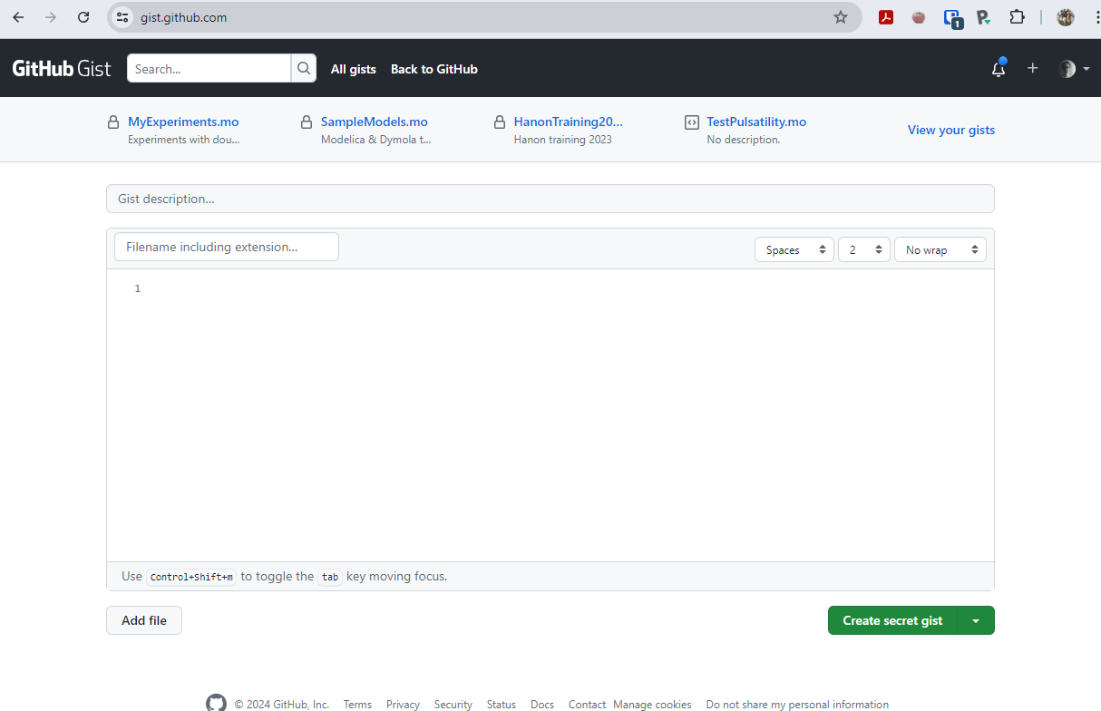
Gist
GitHub service
Fast sharing of code snippets – just send a link
Everything is git-versioned

Slide 34
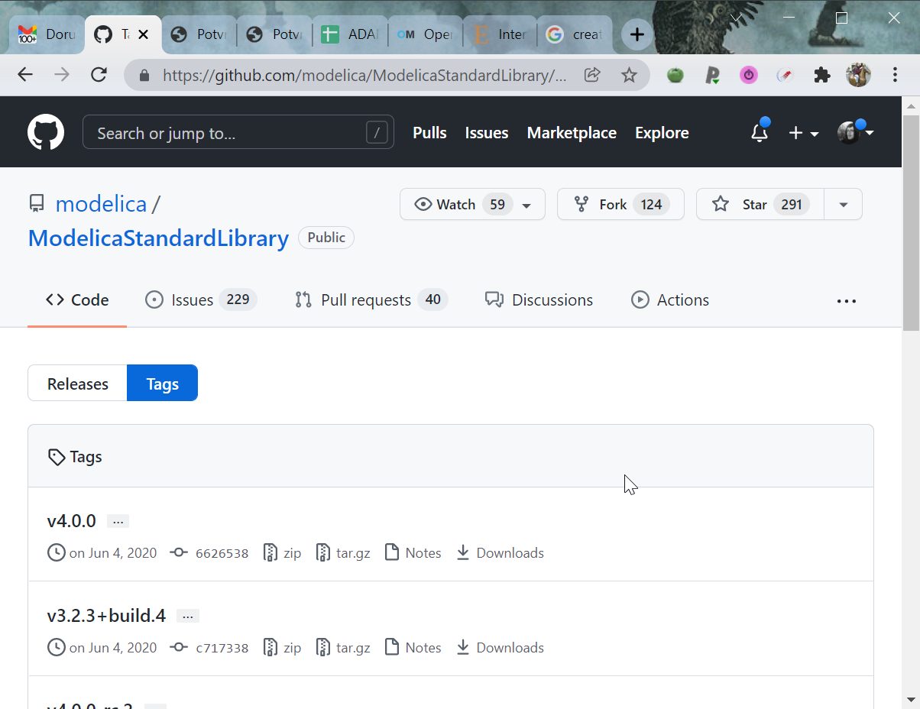
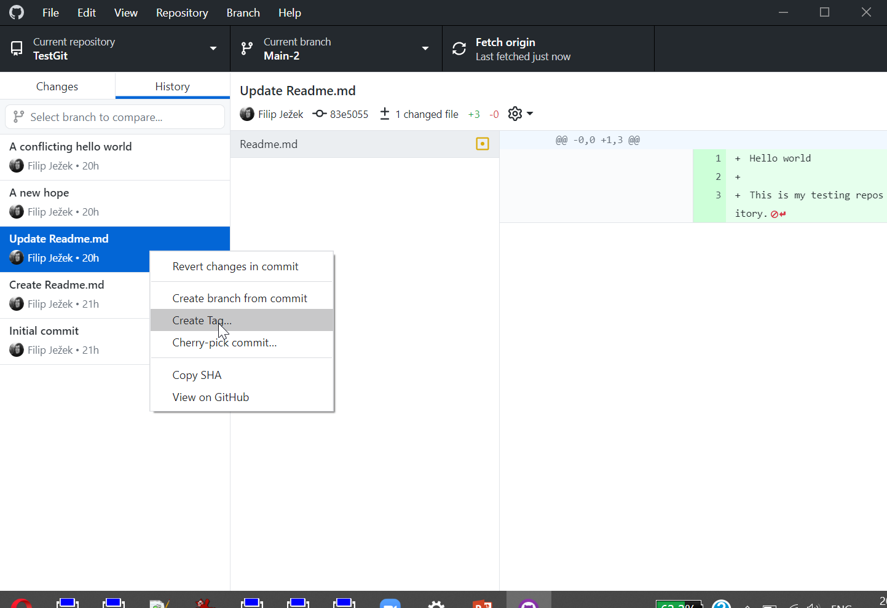
Tags, releases
An “immutable” pointers in time
You release a paper,
you submit a thesis – Tag it!

Slide 35
GitHub
GitHub is more than a source code repository
GitHub Desktop allows only basic workflow
Some functionality of GitHub Desktop taken over to GitHub web itself

Slide 36
Issues, Projects and Actions
GitHub is not just file storage. Three things worth knowing exist above the repository:
Issues — the lab notebook of a codebase
  A bug, a question, a to-do. Numbered, searchable, assignable, and they never get lost in email
  Write “fixes #12” in a commit message and GitHub closes issue 12 when it lands
  The most useful un-taught feature for a research group
Projects — a kanban board over those issues (Todo / Doing / Done)
Actions — run something automatically on every push
  Run the tests · rebuild a figure · check that the model still solves
  Free for public repositories; a monthly quota for private ones
  Realistic first use: one workflow that runs one script and fails loudly if a result changed
Notes:
Tie Actions to reproducibility: a repo that tests itself on every push is a repo whose figures still build in two years.

Slide 37
Big files: Git LFS and the free alternatives
GitHub blocks files over 100 MB, warns over 50 MB, wants repos under ~5 GB
Git LFS — keeps a pointer in Git, the bytes on a server
  git lfs track "*.mat" → writes .gitattributes → commit that file too
  Free tier: 10 GiB storage and 10 GiB bandwidth a month (Free/Pro accounts)
  Bandwidth is counted per download — every clone by every person spends it. That is the part that bites.
Free alternatives, in the order to consider them
  Zenodo / OSF / Figshare — free, versioned, and you get a DOI. Best for data behind a paper
  DVC — free tool, you supply the storage (U-M Turbo, Google Drive, S3). A pointer file lives in Git
  GitHub Releases — attach large assets to a tagged release; outside the LFS quota, but not line-by-line versioned
  Hugging Face Hub — free, git-based, generous limits; good for datasets and models
For this course: keep data out of the repo, script the download, and put the DOI and a checksum in the README.
Notes:
Ask who already has a repo with a .mat file in it. Usually a few hands.

Slide 38
Tidy up
Squish commits into one
Make default (e.g. “main”) branch
Add Readme.md
Format the .md files with markdown
Add a license
Maintain .gitignore

Slide 39
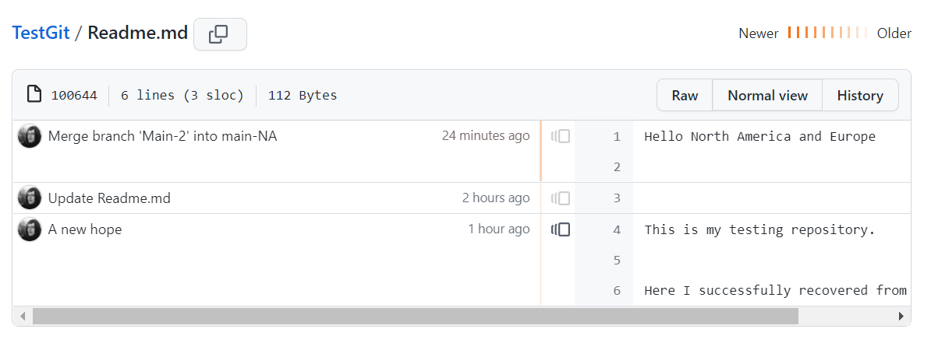
Git blame
Show what line comes from which commit
Handy when debugging history
Navigate to a file in GitHub, select blame

Slide 40
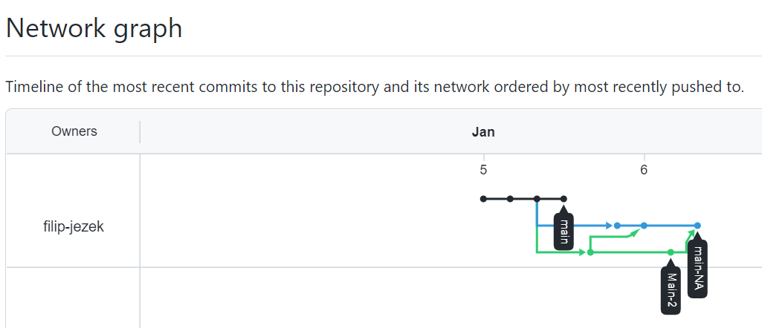
Reflog — your safety net
git reflog lists every commit HEAD has pointed at on your machine, ~90 days back
It is how you come back from a bad reset, a deleted branch, a botched rebase
  Find the hash of the last good state, then git switch -c rescue <hash>
It is local. Not on GitHub, not shared, and it works exactly the same for private repositories as for public ones.
Not to be confused with GitHub's /network graph, which draws the forks and branches of a public repository — a different thing entirely.
GitHub Desktop has no reflog button. This one needs the command line.
Notes:
The old slide said reflog was 'replaced by /network' and 'only for public repositories'. Both wrong, and it hid the single best recovery tool.

Slide 41
GitHub pages
Free hosting
Based on static pages, generated on each commit
E.g. https://filip-jezek.github.io/

Slide 42
More resources
https://www.coursera.org/learn/introduction-git-github
  A free in-depth GitHub course, provided by Google
https://git-scm.com/book/en/v2
  Beginner to expert guide
https://docs.github.com/en/desktop
  GitHub Desktop documentation
https://docs.github.com/en
  GitHub docs

Slide 43
QA — questions from previous years
Everything from here on is reference, not lecture.
Real questions asked by students in earlier runs of this class, with the answers.
  Merging and conflicts · branching · tooling · GitHub · .gitignore · pull requests · publishing · repository size
Read it as homework. If your question is not here, ask it — it goes on next year's slides.
“Something I like about GitHub is that it tracks the history of changes made well.
Something I dislike is that I don't know what I'm doing.”
  — undisclosed participant, and the honest starting point for everybody

Slide 44
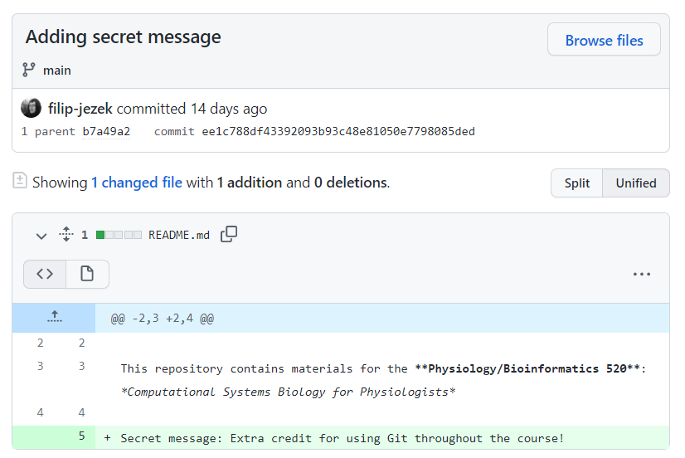
Hidden message
See commit history or file blame
Takeaway: Everything that you commit and push CAN be found.
No need to be afraid of mistakes;
but be careful with any secret / private data!

Slide 45
Merging and Conflicts
If you make a branch and are working on adding a section of code in the middle of your original code and you want to merge, will you have a merge error? Or is there a way to shift down lines of you original code? That way your new code will be inserted in the proper location without replacing any original code.
  I was demonstrating just an edge case, where we were editing the same line, thus the Git cant really decide what is better. But for a simple additions inbetween existing codes, the Git merges automatically.
sometimes it shows ”conflict” and couldn’t merge. What kind of things are conflicted to each other?
  Conflict may happen during merging branches, when it can't be resolved automatically, that is when the same line has been edited on both branches and Git can't decide what should be kept. Otherwise all simple additions and deletes are applied (merged automatically). When files are conflicted, we have to resolve the conflicts before copmleting the merge. So, you could merge conflicts, you just have to oversee the operation and help the Git a bit.
Is there a way to make sure that no one else is working on the same file as you to avoid a merge error?
  No tools will ever eradicate the need to communicate within the team.
    make sure you commit and push as often as possible. Thus, your collague would have a most up-to date version, avoiding conflicts.
    Split up the work, so it is not probable to overlap and finally,
    do not be afraid of conflicts
Can you merge repositories? Would duplicated file names (such as a readme file) cause conflict if you can merge repositories?
  They could merge if they had same parent at some point (e.g. fork). From that point, same files would cause conflicts.
  But it would be easier to just add the files to one of them and resolve manually. KISS!
Is it possible to unmerge branches after the merged branches have been pushed?
  You can revert the Merge commit – this will revert the changes, but the branches are already merged. You can still switch to the other branch and continue there or start AGAIN from the point BEFORE you merged.
When we resolved the merge conflict, we manually deleted the conflict markers. In a more complex conflict, such as source code or data files, where correct resolutions may not be as obvious, is there a faster way to just accept all the changes from one branch and ignore the other, without having to manually delete the conflict markers?
  First, you do not have conflicts in data files – its usually not changing. Binary files can not be tracked line by line, just as a whole – so you need to choose either one. Some other tools (command line, tortoiseGit) can Resolve using mine / resolve using theirs. Don’t overuse branches, keep yourself updated regularly from your origin and you wont run into such problems.

Slide 46
Branching
How do I know when I should make a new branch instead of just committing to the main one?
  If you want to mess around with your project, experiment, do something you might regret later... make a branch. If you go on with your project, just use the main. Typically, one person is working on new feature, while the other one is redoing the very core of the project – each can work separately. Once the core is redone, its merging time. Not very common in school projects. Keep it simple.
What are the best practices for organizing branches in a collaborative project?
  This is not a trivial one. Mainly, use main branch for production and dev branch for new, unstable development. You *can* utilize separate branches for new features being developed – consider in a larger team. Keep it simple.

Slide 47
Git tooling
Do we have to edit files that we save in our directory or can we make changes straight from our github account?
  Actually, both is possible. To make some simple edits to e.g. readme file, it is totally fine to use the web interface. However, if you are programming python or matlab, and you already should be, you better use your local folder. This way you can see all your changes in the staging window, ready to commit (or roll back). Uploading your files from time to time is definitely not recommended (although better than nothing I guess). If you made some changes through github.com though, your Git client wont allow to **push** untill you **pull** all newer changes back to your local repository. This way it prevents any potential conflicts in the remote repository.
What is the name for the subject that stores many repos together? For example, in the github for the R package tidyverse, https://github.com/tidyverse, there are many repos belong to this page. Is this page a repo itself?
  it is called organization. Organization could have a number of public or private repositories, similar to what an individual could have. See the difference in beards-lab: It unifies the collective effort under one brand, the commits are done by individuals (the team) though. You could have unlimited team members here so everyone could write access any of organizational repositories (or a subset of), as long as the organization and its repositories are public. Private repositories and unlimited collaborators are free; organizations pay only for advanced features
for an average programmer, how much GitHub expeirnce do I need?
  The more the better :) Start using it on regular basis. Committing everyday, rolling back every week, being able to get a previous version, branching or merging once a month and doing some serious complicated operation once a year would take imho five years to get you fully professional. Concentrate on doing your job and use git just as you use an elevator - you usually just need to go to your fifth floor and back, thats about it. But if you are moving furniture, it comes really handy and I am pretty confident you will find a way when the need arises.
What other tools are there in Github?
  It is a large ecosystem – Issue tracker with project management (i.e. kanban cards) wiki, GitHub pages (statically generated through Jekyll), continuous integration – hooks on commits, e.g. compiling, running tests etc

Slide 48
Github
Does git owe its dominance to its own merits or to the tooling that has been developed around it?
  Due to its own merits and being open it was subsequently adopted by wide tooling. It started as a CLI tool, but adopted by linux devs from the very beginning. Big initial challenge resulted in great reputation.
Is there an importance in having a good GitHub profile or track for future job applications/coding careers?
  Of course! Some developers are even “investing” into their careers by contributing into community open-source projects. Where else would you go if you want to check if your new programmer has some experience?

Slide 49
.GitIgnore
I am using MacOS, is there any way to get rid of the .DS_store file that persists in my 'changes' to commit? I have already chosen to send it to the .gitignore file, but it did not fix the problem.
  - adding .DS_store into .gitignore should do the trick. I have just updated the .gitignore, try pulling from **"upstream"** or fetching your github.com repository to match the upstream.
If I edit the gitignore file, I make some file visible and not visible. Why you said it was not reversible?
  Once committed, the file would always get change-tracked. You can delete it from the repo, commit and copy back – now it can be ignored and not tracked

Slide 50
Pull requests
How do I resolve conflicts in pull requests when working with a team?
  The maintainer needs to resolve that, usually by noticing the issuer to merge the updated version and resolve himself
Can I request a pull for several files I changed together or I need to do it one by one?
  - the pull request is actually a merge of your whole branch. So whatever you do in YOUR fork (your copy of my repository), be it one or dozen new files, edits and deletes, is contained in your pull request.
What is the social ettiquite for submiting bug fixes and edits to someone else's code in a shared project (so as not to be disrespectful).
  1. Do not be a jerk.
  2. Publicly listing an issue / pull request / feature request is way better than emailing/contacting separately the author to do this and that and that you have found a major flaw / issue, feature request. People usually maintain their project through GH already, so do not cross the system.
  3. IF your motivation is to contribute to the project and make it better, go ahead and fear not.

Slide 51
Publishing issues
Is it alright to publish code that other people have contributed to?
  Yes, as long as you respect the licence. Most of the repositories published at GitHub do have a licence file. This is mostly MIT (use as you want, even for commercial use) or variants of GNU licence. If someone contributes to your repository, she has to be comfortable with that license. On the other hand, you should acknowledge his co-authorship. - if you have some code that you worked on together with other people, you probably should agree on a licence of their contribution - be it MIT, GNU, some proprietary one or not to share at all.
Do tags exist only in GitHub, or are they a feature of git repositories (whether they are managed in GitHub or not)?
  It is a general feature. You can right-click any commit in GH-Destkop and select Create Tag. Remember, that whatever you can do with **GitHub Desktop** (not using any web features), you can also do with ANY other git client (and usually more). Tag is just a pointer on a specific commit, immutable in time. Github.com then presents all the tags and releases nice and pretty.
Can you share a private repository (without making it public for everyone)?
  Sure! GitHub provides to add a collaborators to private repositories. You can have private repositories under institutional pages (e.g. beards-lab), which are accessible for the team only.
Can anyone clone my respository? How do I set permissions on who can access code I push to Github?
  YES! That is the point! If you do not want to share, just set the repo to private. Once private, you can manage who gets the access.
I don't love the idea of 1 mistake with private information could result in major major problems due to how repositories work and being on various machines.
  You also do not let your credit card circle around - you simply do not put private info in the shared folder.
I am able to access the assignment repository, but is just anyone able to? Is posting to GitHub the making public part and anything that should be private is on the local?
  Yes, since it is public. The private then is not seen by anyone. Forking something public makes it public too (can be reset in settings).

Slide 52
Class
For class projects, should we utilize **Conventional Commits** or keep messages simple and short?
  This is a next-level question. If you are familiar with conventionalcommits.org go on, use it and teach your group!
Can we use gitlab for repos in this class
  You *can* use whatever works for you, using Git is encouraged, using GitHub was just demonstrated for its simplicity and widespread.
What's the recommended workflow in using Github for this BIOINF 520 class.
  You create your own repository with all the assignments and codes, committing regularly. Your future self will be proud of you. You do not even have to make it public!

Slide 53
Other
Why does git command line exist if github desktop is a thing?
  - *First, Git comes from the Unix people. They love command line. They might die without touching the keyboard regularly :) Most of the git tools are just a GUI on top of these commands. Second, it is often used in the help files, because that is the right way to do, regardless in which menu item or under which name it is hidden in different git clients. GitHub desktop is only one of such clients. I personally find nice, that all the commands are somwhat hidden from us. You can however grab any other tool to use with Git or GitHub.*
Can I write into files within a repository from the command line?
  - *Something like https://superuser.com/questions/186857/how-do-i-edit-text-files-in-the-windows-command-prompt ? The repository is basically your local folder. Or you meant accessing the history, commiting, pushing, and all that stuff? The Git has been designed for command line, but I am no expert on the commands. The https://git-scm.com/docs/ should have your back. But unless you are a big nerd {no offence), you are just fine to stick to any GUI tool you like (the GitHub desktop is possibly the simplest and most user-friendly one). You can of course edit your files directly in the github.com, but this is really impractical (that is, do not do it!) for your source codes.*
Can two repositories be merged? I'm not sure why this would have to happen, but I'm curious.
  Yes, though it is quite an extreme case. You can have more than one "origin" sources. But this is impractical and could do more harm than good.
Is there a size limit to the repository?
  individual files are blocked above 100 MB (GitHub warns above 50 MB) and the whole repository is recommended to be under 5 GB, which is fine even for large projects, as long as you don't commit binaries
How much size can the `~/.git` directory take? Worried about this especially if it’s a large project.
  Is a Linux core a large project? It was designed for this purpose. The source code is zipped, having only minimal footprint then. Remember, do not track generated binary files – each time they get regenerated they are versioned and stored! Otherwise, even a large project, will hover around 10 - 500MB, which is acceptable.

Slide 54
Other
What will happen if I use ```--force``` option in ```git push```?
  Usually nothing. The force option is to override the otherwise forbidden pushes – like pushing when not the last commit, pushing rebased branch etc.
I think that as files grow bigger and there are more changes, it would get really complex to navigate branches and file versions. I'm worried about how that will work with other collaborators as well.
  The history is usually linear. Once the branches merge, it gets linear again. No big deal, honestly. To orientate better, create releases and tags.
Is it true that we can only have .gitattribute under the root of the repository?
  You can have as many as you want. But only the one is used to define the settings.
  Settings can include various stuff like line endings (CRLF / LF), what to consider as binaries and other next-level repository level settings.
How does using "git fetch upstream" help in keeping a forked repository up-to-date with the original repository, and what steps should follow to integrate the fetched changes into your local branch?
  This will synchronize your fork with the parent, upstream repository. Imagine I have added new content AFTER you forked – it would not get updated automatically, you have to fetch upstream.
Will there only be one administrator for each repository?
  There can be more, for sure!

Slide 55

Take away
Use Git & Commit!
Push sometimes
Ask for more
KEEP IT SIMPLE!
  Commit!
  Do not overuse branches

Slide 56
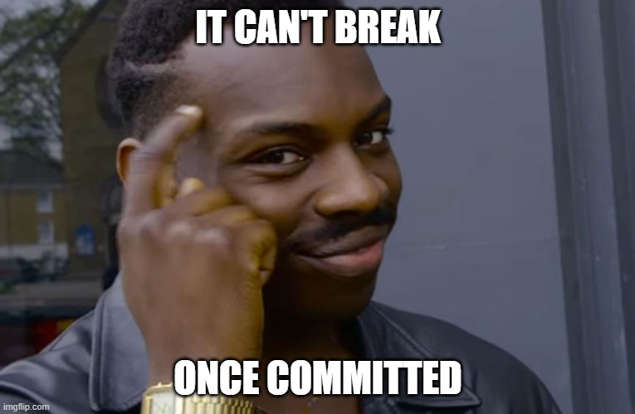
More help
Filip Ježek
fjezek@umich.edu

